Slide 1
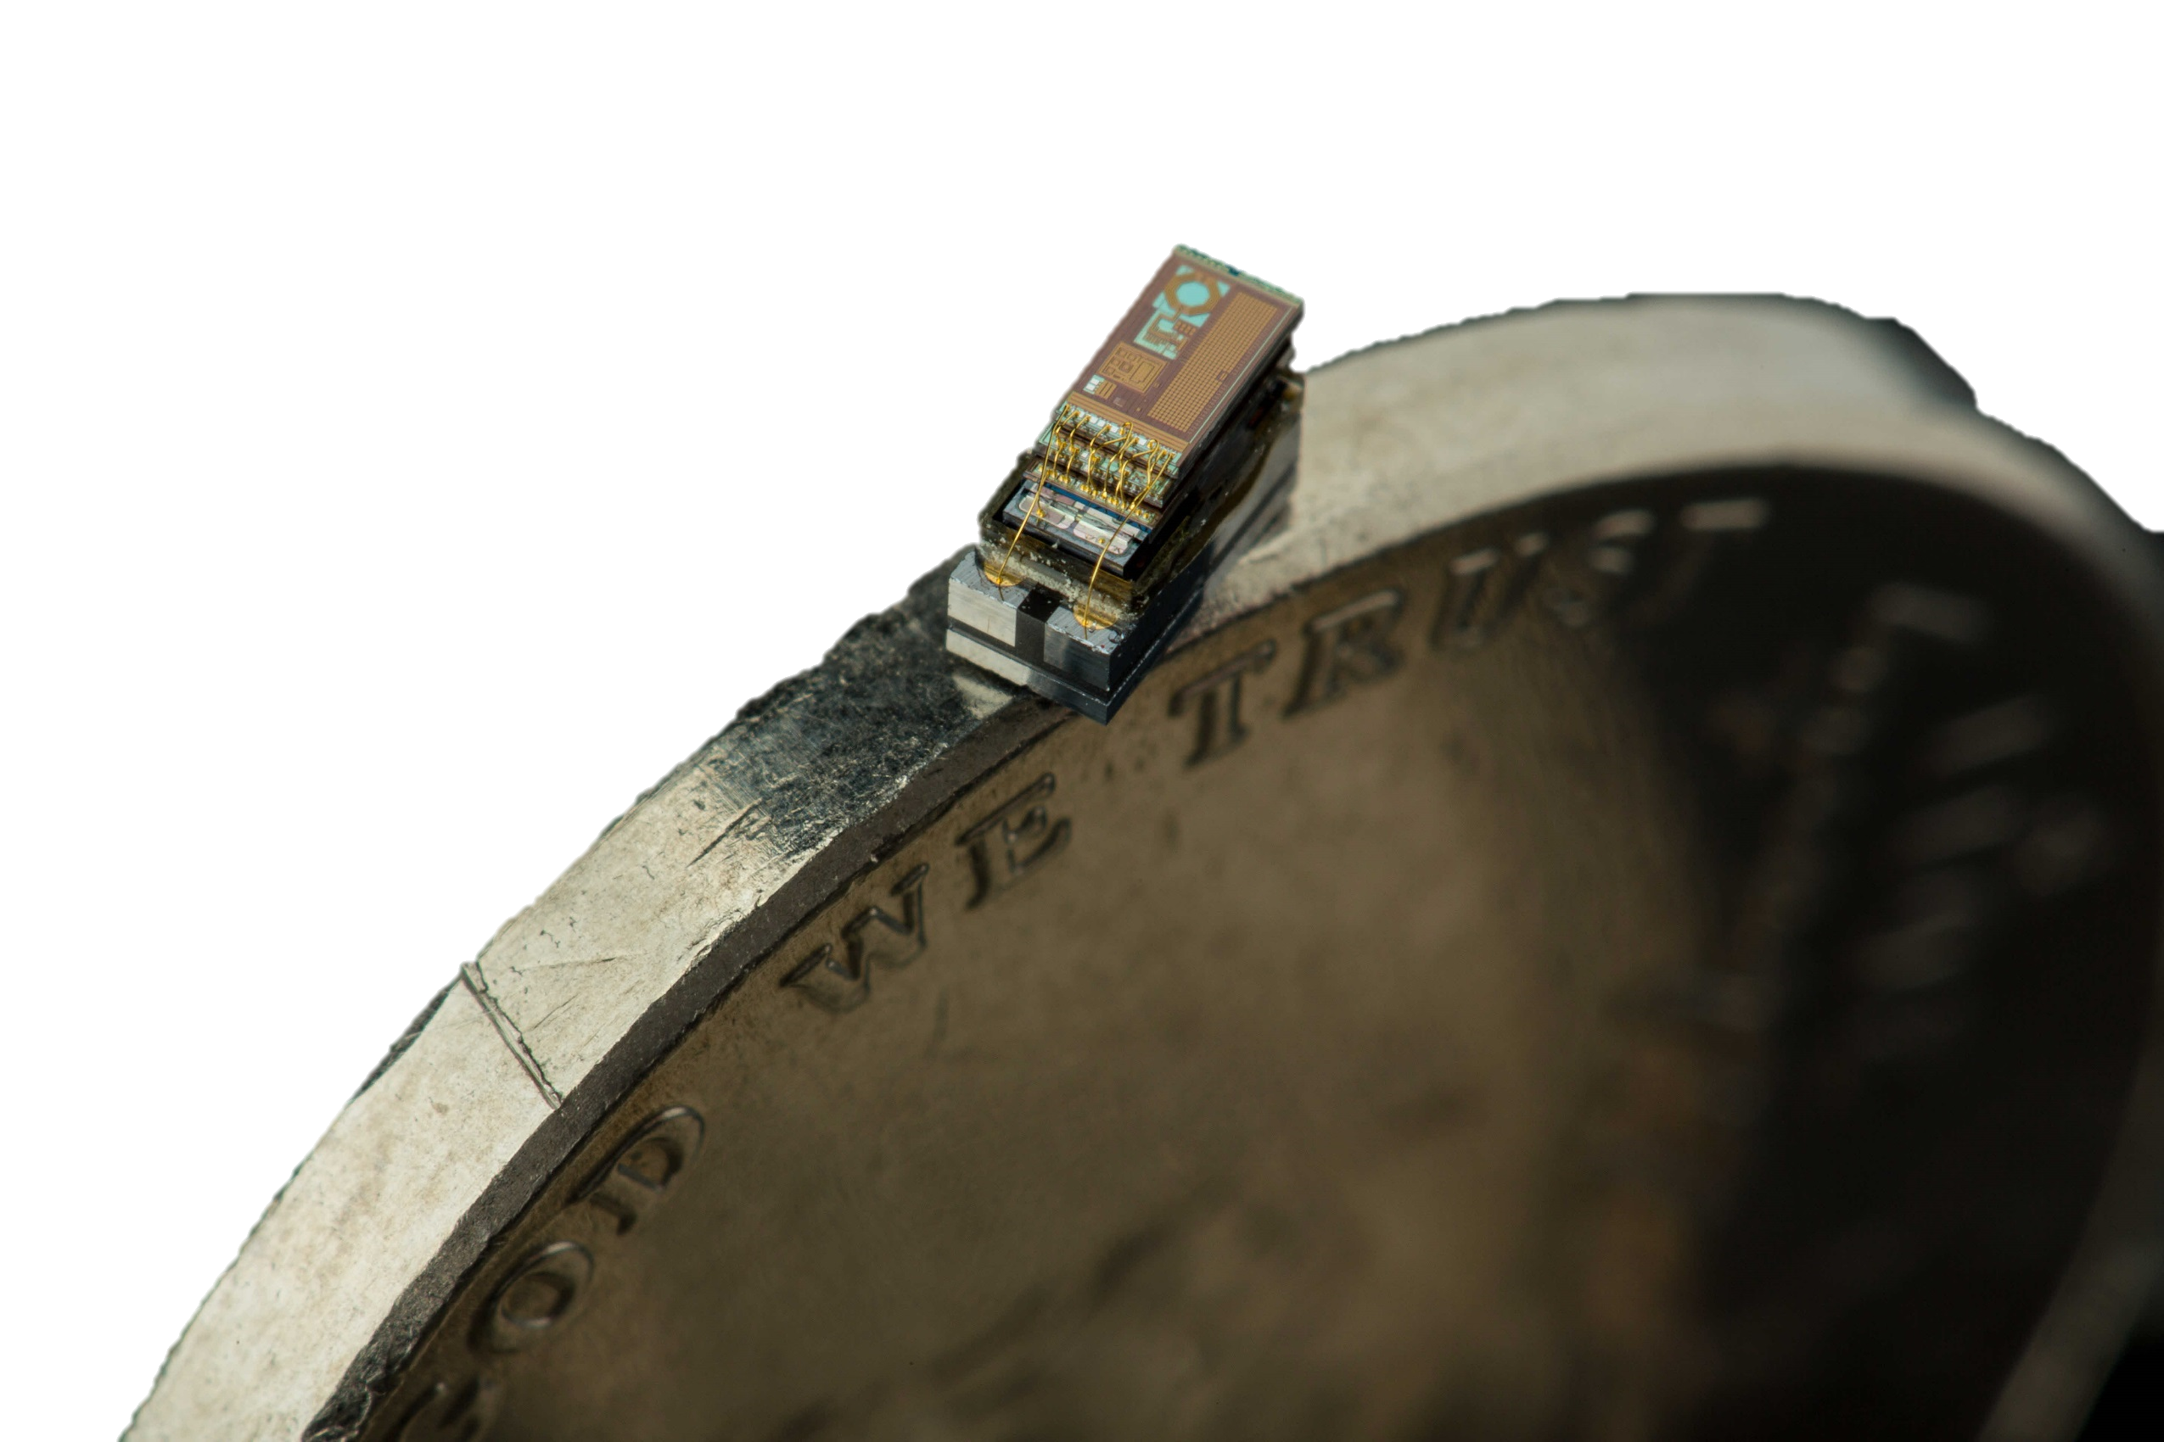
MBus An Ultra-Low Power Interconnect for Next Generation Nanopower Systems
Pat Pannuto, Yoonmung Lee, Ye-Sheng Kuo, ZhiYoong Foo, Benjamin Kempke, Gyouho Kim, Ronald G. Dreslinski, David Blaauw, and Prabal Dutta
University of Michigan
The 42nd International Symposium on Computer Architecture (ISCA’15)
June 13-17, Portland, Oregon, USA

Slide 2

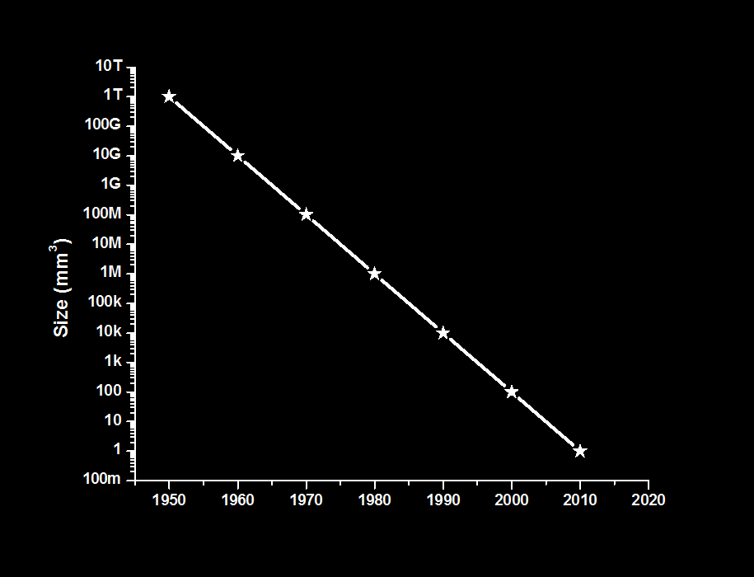
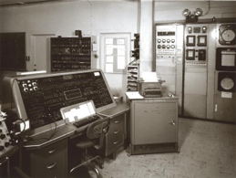
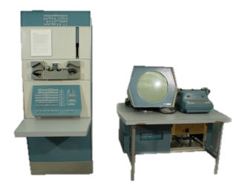


Bell’s Law: A new computing class every decade
Corollary:
100x smaller / decade
1 per Enterprise
1 per Engineer
Size (mm³)
Laptop
1 per Professional
“Smart Dust” should arrive by ~2017
1 per Company
1 per Family
1 per person
Graphic originally from Dennis Sylvester

Slide 3
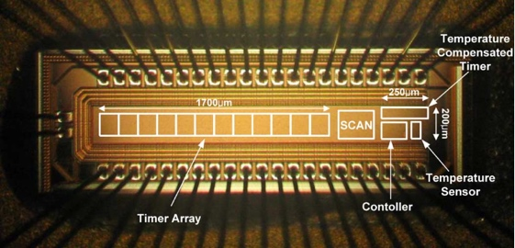
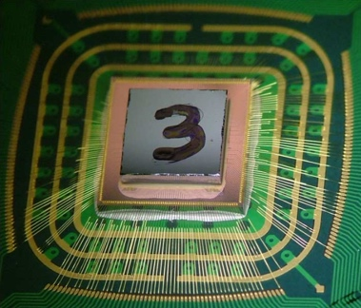
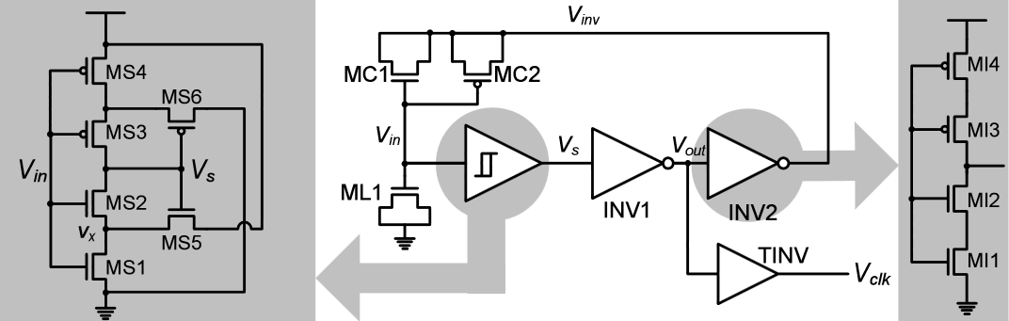
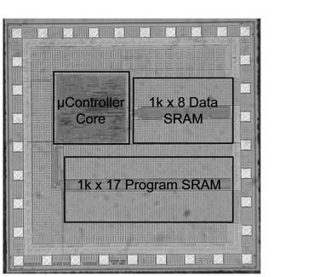
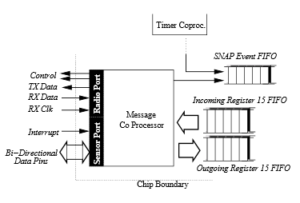
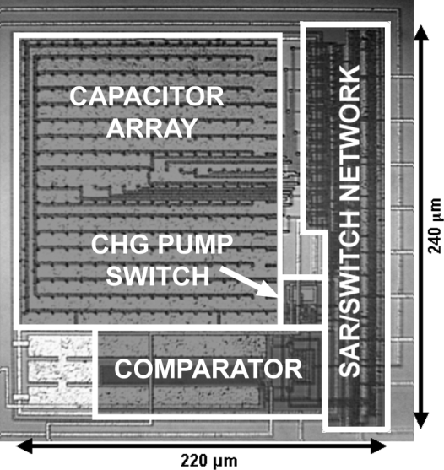
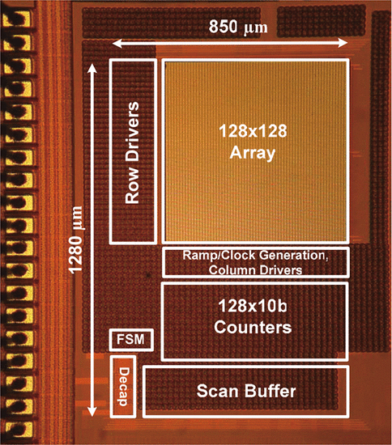
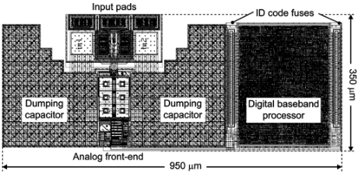
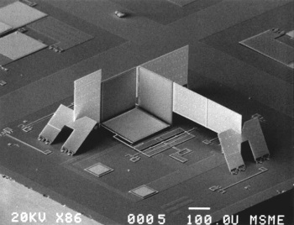
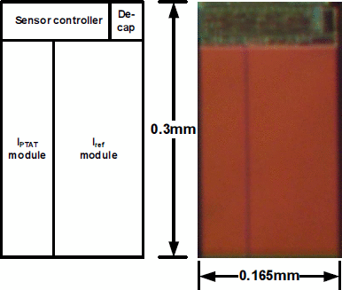
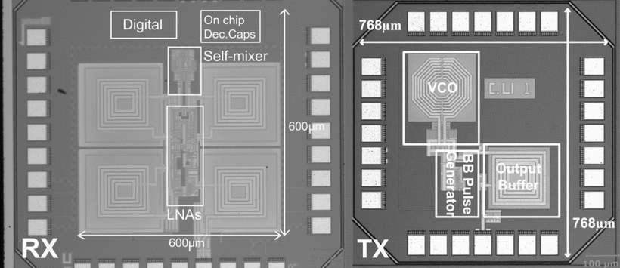
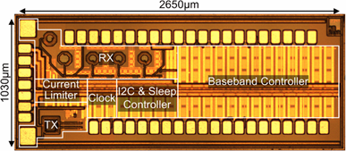
We have a diverse array of mm-scale components
Timers
Power Management
CPUs
Y.-S. Lin ‘07
Y. Lee ‘13
N. Sturcken ‘13
V. Ekanayake ‘04
ADCs and Sensors
Communication
B. Warneke ‘04
S. Hanson ‘09
A. Ricci ‘09
P. Chu ‘97
M. Scott ‘03
M. Crepaldi ‘10
J. Brown ‘13
Y.-S. Lin ‘08

Slide 4
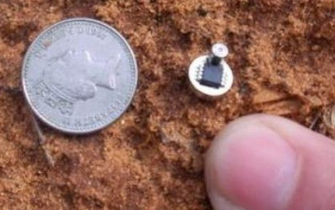
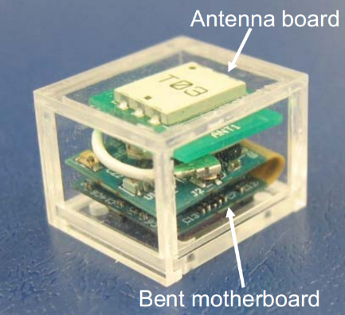
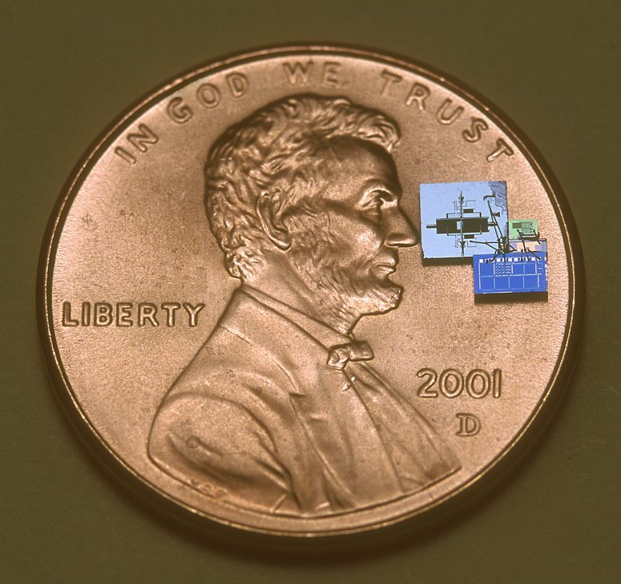
And a few mm-scale systems…
Smart Dew
The 1cc Computer
Smart Dust
Y. Shapira ‘08
T. Nakagawa ‘08
B. Warneke ‘07

Slide 5
But where is the next class of computing?
1 per Enterprise
1 per Engineer
Size (mm³)
Laptop
1 per Professional
?
1 per Company
1 per Family
100 – 1000’s per person
1 per person
Smartphone
Graphic originally from Dennis Sylvester

Slide 6
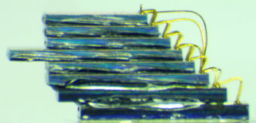
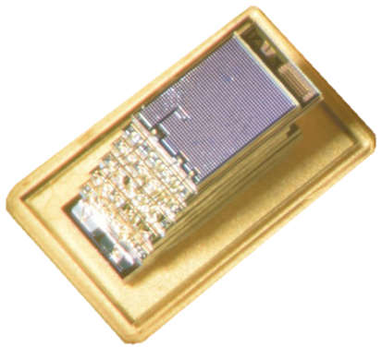
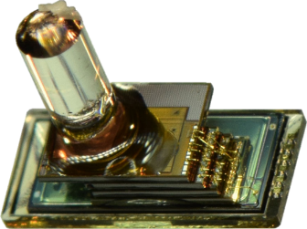
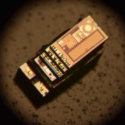
MBus is the missing interconnect that enables the mm-scale computing class
22.6 pJ / bit / chip, < 10 pW standby / chip
Single-ended (push-pull) logic
Low, fixed wire count (4)
Multi-master
Power-aware
Implemented in over a dozen (and growing) mm-scale chips
CPU, Radio
Flash Memory
Temperature, Pressure, Imager
To make half a dozen (and growing) mm-scale systems

Slide 7
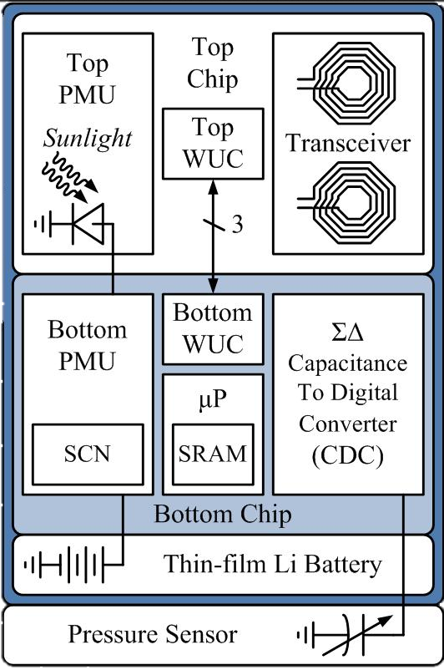
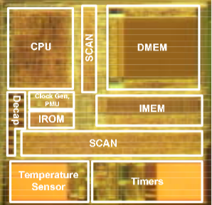
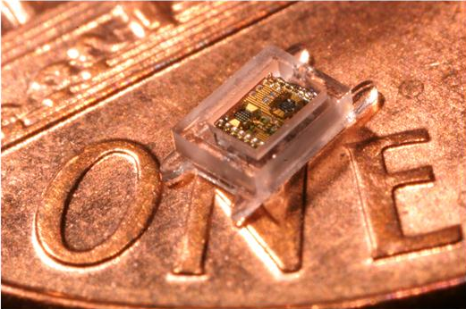
Modularity is key for fast, iterative design, but was previously absent from mm-scale systems
Phoenix 2008:
World’s lowest power computer
Basically a temperature sensor
Intraocular Pressure 2011:
Collaboration for glaucoma health
A pressure sensor
From mm-scale temperature sensor to mm-scale pressure sensor took 3 years
The Phoenix Processor: A 30pW Platform for Sensor Applications, Mingoo Seok, Scott Hanson, Yu-Shiang Lin, Zhiyoong Foo, Daeyeon Kim, Yoonmyung Lee, Nurrachman Liu, Dennis Sylvester, David Blaauw , VLSI ‘08
A Cubic-Millimeter Energy-Autonomous Wireless Intraocular Pressure Monitor, Gregory Chen, Hassan Ghaed, Razi-ul Haque, Michael Wieckowski, Yejoong Kim, Gyouho Kim, David Fick, Daeyeon Kim, Mingoo Seok, Kensall Wise, David Blaauw, Dennis Sylvester, ISSCC ‘11

Slide 8
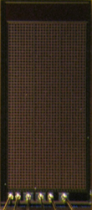
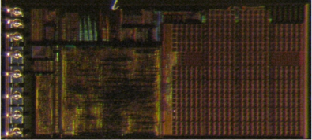
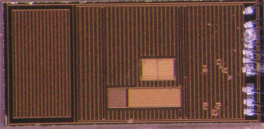
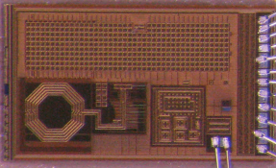
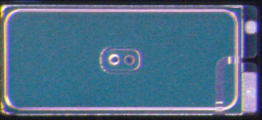
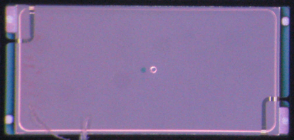

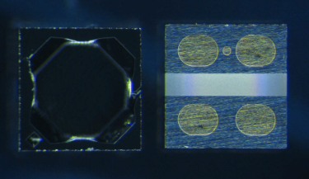
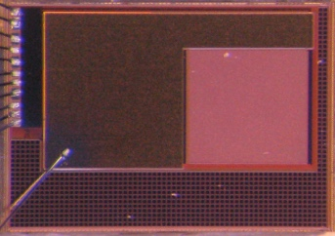
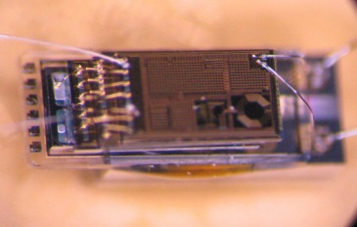
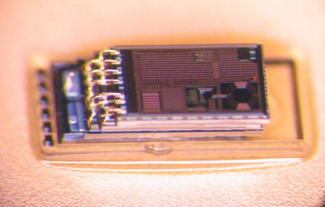
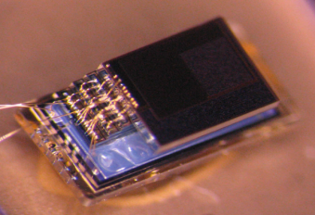
MBus enables a modular, composable ecosystem of mm-scale components
From temperature sensor to pressure sensor:
3 months.
Control/
PMU
Decap
Temp Sensor
Radio
+ CDC
2 uAh Battery
5 uAh Battery
MEMS
P. Sensor
Motion Detection/ Imager
Pressure Sensing
Temp. Sensing
Visual Sensing
Notes:
Modularity is one of the most important things in arch; when useful integrate. Currently mm-scale systems prematurely integrate due to artificial constraints

Slide 9
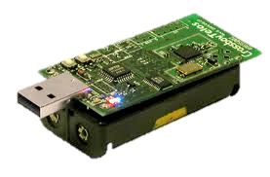
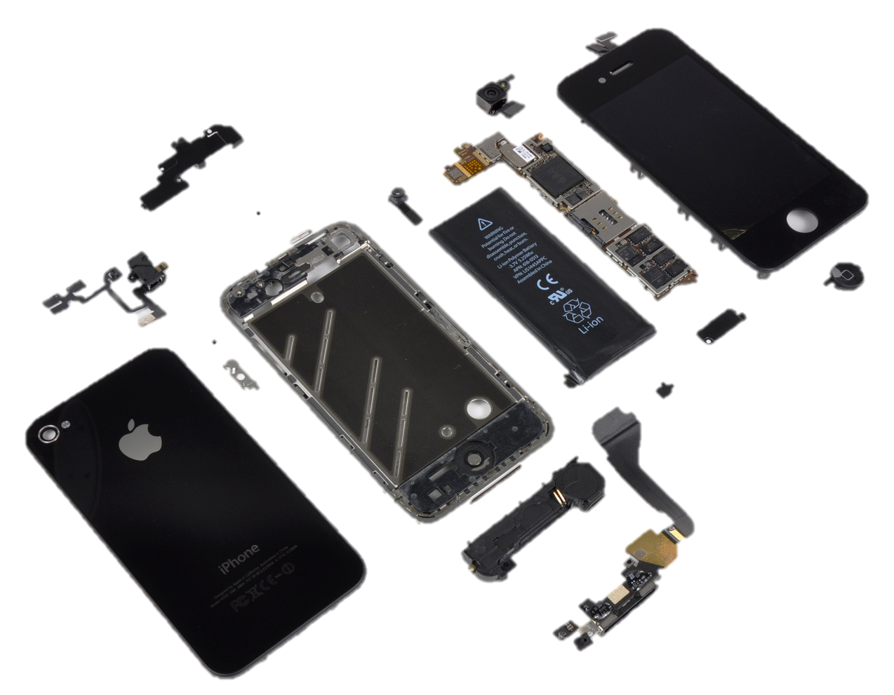
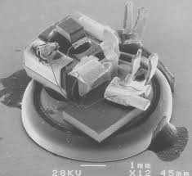
Existing interconnects have served us well for 30 years. What makes mm-scale systems unique?
Node volume is dominated by energy storage
And volume is shrinking cubically
“Phone”
Battery
“Sensor”
Batteries
“Sensor”
Battery
10’s μW active, 10’s nW sleep, DC 0.1%

Slide 10
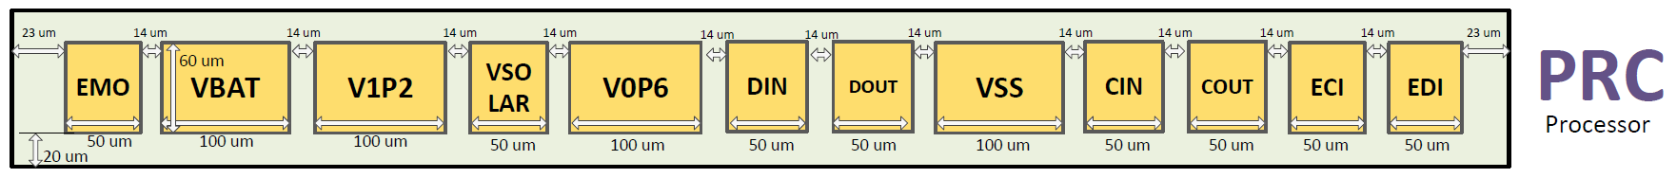
Existing interconnects have served us well for 30 years. What makes mm-scale systems unique?
Node volume is dominated by energy storage
And volume is shrinking cubically
I/O pads begin to account for non-trivial percentage of node surface area
“Phone”
Battery
“Sensor”
Batteries
1 mm = 1,000 μm
50 μm, minimum viable bond pad
“Sensor”
Battery
16-20 maximum I/O pins for 3D stacking
10’s μW active, 10’s nW sleep, DC 0.1%

Slide 11
SPI and I²C are like the USB and Firewire of embedded interconnects
Nearly every microcontroller has both
Nearly every peripheral has one or the other
Very few use anything else
(except maybe UART)

Slide 12
What is wrong with how are systems composed today?
SPI, invented by Motorola in ~1979
One master, N slaves
Shared clock: SCLK
Shared data bus: MOSI
Shared data bus: MISO
One Slave Select line per slave
Key Properties
One dedicated I/O line per slave
Master controls all communication
Master
Slave 1
SCLK
MOSI
MISO
SS0
SS1
…
SCLK
MOSI
MISO
SS
Slave 2
SCLK
MOSI
MISO
SS
Notes:
Extremely populare; almost all MCUs have this interface

Slide 13
What is wrong with how are systems composed today?
SPI, invented by Motorola in ~1979
One master, N slaves
Shared clock: SCLK
Shared data bus: MOSI
Shared data bus: MISO
One Slave Select line per slave
One interrupt line per slave
Key Properties
One Two dedicated I/O lines per slave
Master controls all communication
Interrupts must be out-of-band
Master
Slave 1
SCLK
MOSI
MISO
SS0
SS1
…
GPIO0
GPIO1
…
SCLK
MOSI
MISO
SS
INT
Slave 2
SCLK
MOSI
MISO
SS
INT

Slide 14
SPI’s I/O overhead and centralized architecture do not scale to mm-scale systems
SPI, invented by Motorola in ~1979
One master, N slaves
Shared clock: SCLK
Shared data bus: MOSI
Shared data bus: MISO
One Slave Select line per slave
One interrupt line per slave
Key Properties
One Two dedicated I/O lines per slave
Master controls all communication
Interrupts must be out-of-band
Master
Slave 1
SCK
MOSI
MISO
SS0
SS1
…
GPIO0
GPIO1
…
SCLK
MOSI
MISO
SS
INT
Slave 2
SCLK
MOSI
MISO
SS
INT

Slide 15
I²C has fixed I/O requirements and a decentralized architecture
I²C, invented by Phillips in 1982
Any-to-(m)any on one shared bus
Key Properties
Fixed wire count (2)
Node1
Node2
Node3
SCL
SDA
SCL
SDA
SCL
SDA

Slide 16
I²C has fixed I/O requirements and a decentralized architecture
I²C, invented by Phillips in 1982
Any-to-(m)any on one shared bus
Key Properties
Fixed wire count (2)
Open-collector
Multi-master
Flow Control
Node1
Node2
Node3
SCL
SDA
SCL
SDA
SCL
SDA
Open-collector (aka wired-AND)

Slide 17
The problem is the energy costs of running an open-collector
@400 kHz
V_{DD} = 1.2 V
No setup, no hold
R = 15.5 kΩ
(“the best”)
80% V_{DD} as 1
Send a “1”: 0 J
Send a “0”: 174 pJ

Slide 18

The problem is the energy costs of running an open-collector
@400 kHz
@400 kHz
V_{DD} = 1.2 V
No setup, no hold
Bigger R?
R = 15.5 kΩ
(“the best”)
80% V_{DD} as 1
Send a “1”: 0 J
Send a “0”: 174 pJ
SCL Alone: 70 μW

Slide 19
The problem is the energy costs of running an open-collector
@400 kHz
@400 kHz
V_{DD} = 1.2 V
No setup, no hold
Active Energy Budget: 20 μW
Not an arbitrary number:
Volume Target
Lifetime Target
R = 15.5 kΩ
(“the best”)
Two batteries
80% V_{DD} as 1
Send a “1”: 0 J
Send a “0”: 174 pJ
SCL Alone: 70 μW
~ 3.1 mm

Slide 20
The energy demands of open-collectors make them unsuitable for mm-scale systems
@400 kHz
Active Energy Budget: 20 μW
Not an arbitrary number:
Volume Target
Lifetime Target
Two batteries
SCL Alone: 70 μW
~ 3.1 mm
Notes:
Design for 20, try to hit 40 in practice

Slide 21
Can we modify I²C to bring energy costs in line with mm-scale?
Master
Slave1
Slave2
SCL
SDA
SCL
SDA
SCL
SDA

Slide 22
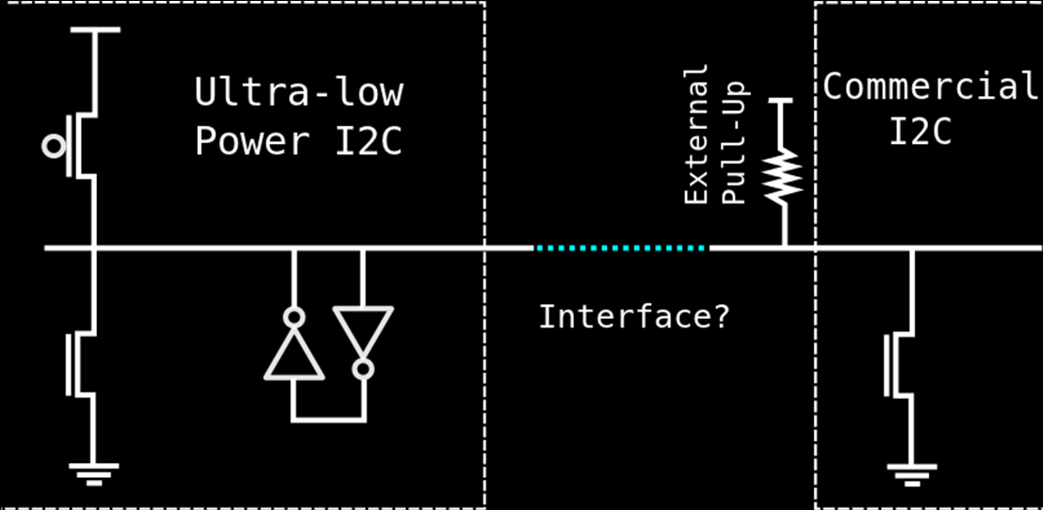
Replace the passive pull-up resistor with active circuitry
The Good : Able to achieve 88 pJ / bit (measured)
The Bad : Required clocks running at 5x bus clock on every chip
A Modular 1 mm³ Die-Stacked Sensing Platform with Low Power I2C Inter-die Communication and Multi-Modal Energy Harvesting
Yoonmyung Lee, Suyoung Bang, Inhee Lee, Yejoong Kim, Gyouho Kim, Mohammed Hassan Ghaed, Pat Pannuto, Prabal Dutta, Dennis Sylvester, David Blaauw
IEEE Journal of Solid-State Circuits

Slide 23
Replace the passive pull-up resistor with active circuitry
The Good : Able to achieve 88 pJ / bit (measured)
The Bad : Required clocks running at 5x bus clock on every chip
The Bad : “I²C-like” is not I²C – required FPGA to integrate with COTS chips
The Ugly : Hand-tuned, ratioed logic on every chip – Not synthesizable
Ultra-Constrained Sensor Platform Interfacing
Pat Pannuto, Yoonmyung Lee, Benjamin Kempke, Dennis Sylvester, David Blaauw, and Prabal Dutta
IPSN 2012 (Demo)

Slide 24
“Dark silicon” is more like “dimly lit silicon”
Clock-gated modules still exhibit static leakage
Blows mm-scale power budget
mm-scale systems perform power-gating
This means modules are cold-booting all the time
Manageable for monolithic designs because something always powered on
CPU
Radio
Timer
Sensor
Flash

Slide 25
Modular mm-scale components introduce novel circuits problems and novel systems problems
Clockless cold boot circuits are tricky
How do you know what’s awake?
How do you communicate with “pitch black” silicon to wake it up?
I²C-variant: custom “wakeup” signal
CPU
Radio
Timer
Sensor
Flash

Slide 26
The MBus design follows from a careful consideration of all the requirements for modular, mm-scale systems
Clock
Ring Topology
2 lines – 4 I/O per node
Clock
Data
“Shoot-Through”
MBus Mediator
Data
MBus Member
MBus Member
MBus Member
MBus Member
CLK_IN
CLK_OUT

Slide 27
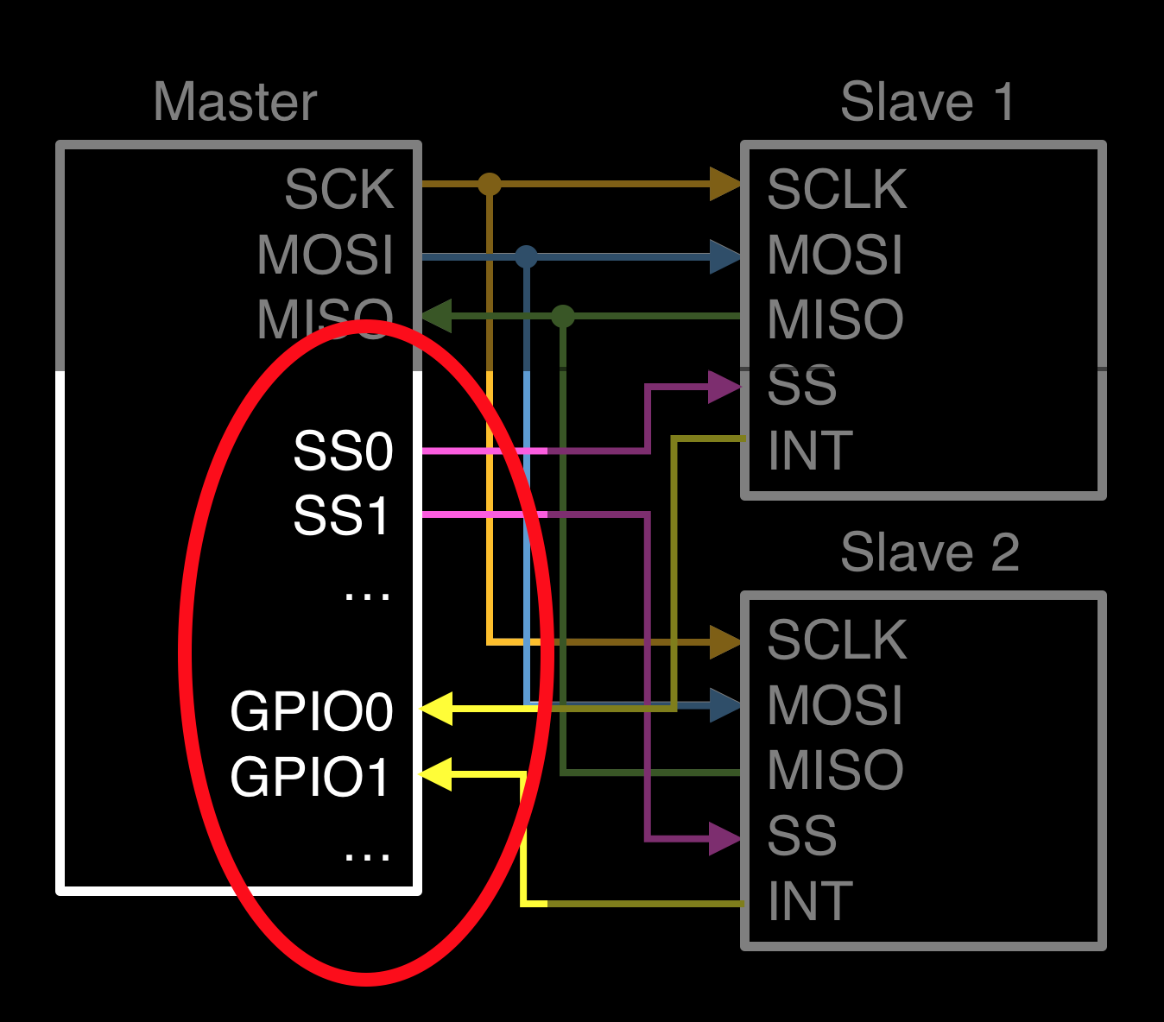
To be extensible and respect I/O constraints, wire count must be independent of node count
MBus Mediator
Clock
Recall SPI:
Data
MBus Member
MBus Member
MBus Member
MBus Member

Slide 28
Supporting interrupts with a fixed number of single-ended connections requires an arbitration protocol
Arbitrate
MBus Mediator
Clock
Recall: “shoot through”
C wants to send a message
Stop forwarding, drive 0
The mediator does not forward during arbitration
Also generates the bus clock
1
1
1
1
DATA_IN
0
1
1
DATA_OUT
D
A
Data
0
1
1
1
1
0
0
C
B
1
1

Slide 29
Supporting interrupts with a fixed number of single-ended connections requires an arbitration protocol
Arbitrate
MBus Mediator
Clock
Recall: “shoot through”
C wants to send a message
Stop forwarding, drive 0
The mediator does not forward during arbitration
Also generates the bus clock
0
0
1
1
0
1
1
DATA_IN
0
1
1
DATA_OUT
D
A
Data
0
1
0
0
1
1
1
0
C
B
1
0
1

Slide 30


Supporting interrupts with a fixed number of single-ended connections requires an arbitration protocol
Arbitrate
MBus Mediator
Clock
What changes if B tries to send as well as C?
B and C drive DATA_OUT to 0
B’s DATA_IN high, wins
C’s DATA_IN low, loses
MBus has topological priority
1
0
1
0
1
0
1
1
0
1
1
D
A
Data
0
1
0
0
1
1
1
0
C
B
0
0
1
0
1
Notes:
Transition: Now that we know who’s talking, how does the node declare who it’s talking to?

Slide 31
Tradeoff between globally unique addresses, address length, and overhead
Arbitrate
Address
Embed addresses in message frames
Overhead proportional to number of uniquely addressable device
I²C uses 7-bit device addresses with design-time LSBs
Requires I/O not available
Makes packaging assumptions
mm-scale systems not always PCB
Routing may not be easy
3D stack
Flip-chip + TSVs

Slide 32
Tradeoff between globally unique addresses, address length, and overhead
Arbitrate
Address
3 Options
Short static addresses and allow device conflicts
Long static addresses to avoid device conflicts
Non-static addresses
MBus does all 3
4-bit: Static short prefixes (device class)
24-bit: Static long prefixes (unique device ID)
4-bit: Runtime enumeration protocol (replaces short prefix)
Notes:
Mention broadcast messages orally

Slide 33
Unbounded messages maximize flexibility and minimize overhead
Arbitrate
Address
An MBus message is 0…N bytes of data
Embed length in message
Imposes large overhead for short messages
Forces fragmentation of long messages
“End-of-message” sentinel byte(s)
Imposes large overhead for short messages
Requires escaping if sentinel is in transmitted
Data-dependent behavior, hard to reason about
Worst case 2x overhead!
Data

Slide 34
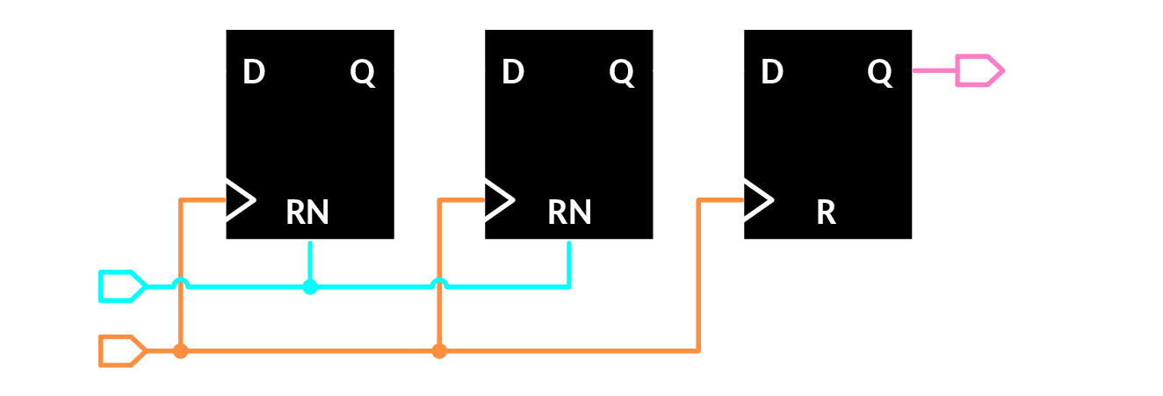
MBus “interjections” provide an in-band end-of-message with minimal overhead
Arbitrate
Address
During normal operation, Data toggles slower than Clock
Data
Clock
Data
Data
Interject

Slide 35
MBus “interjections” provide an in-band end-of-message with minimal overhead
Arbitrate
Address
During normal operation, Data toggles slower than Clock
Data
Clock
Data
Interject

Slide 36
MBus “interjections” provide an in-band end-of-message with minimal overhead
Arbitrate
Address
During normal operation, Data toggles slower than Clock
ACK
Data
Clock
Data
Interject
Idle
control

Slide 37
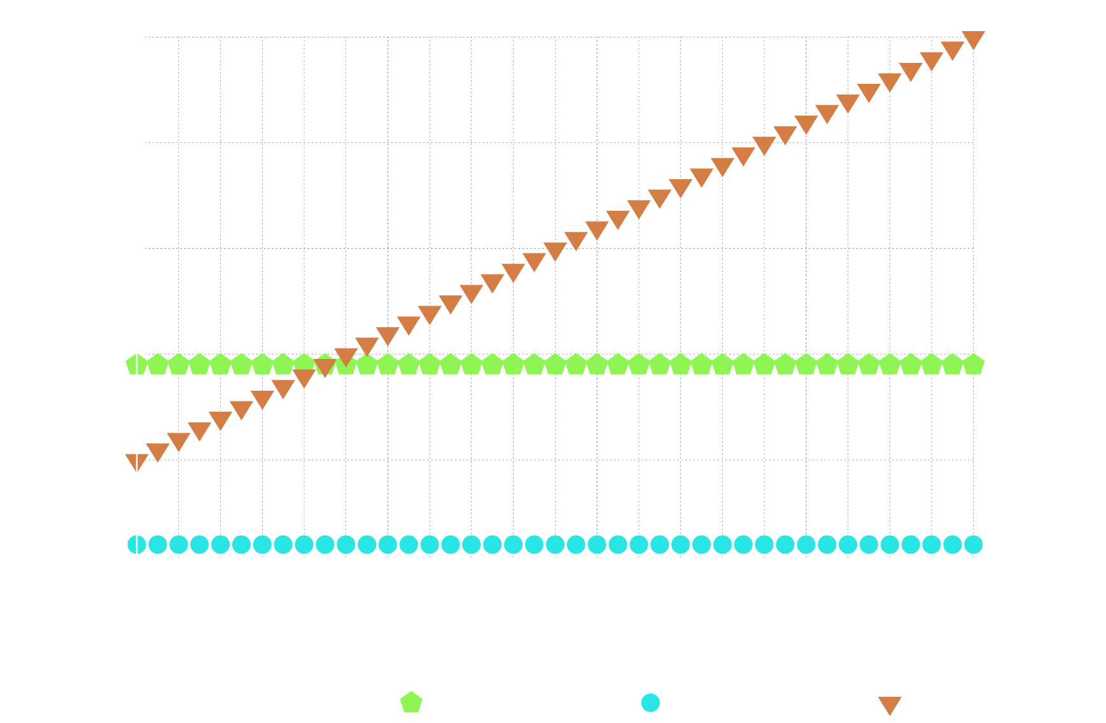
Transaction-level ACKs minimize common-case overhead while interjections preserve flow control
Arbitrate
Address
Data
9 bytes
Interject
Arbitration
+
Address
+
Interjection
control

Slide 38
The modularity enabled by MBus created a circuits problem and a systems problem
Arbitrate
Address
Clock
Clockless cold boot circuits are tricky
How do you communicate with “pitch black” silicon to wake it up?
How do you know what’s awake?
A power-gated node cannot send
Use arbitration edges to drive the cold-boot circuitry
(Minimal frontend: 35 gates, 4 regs)
Nodes awaken before addressing
Nodes appear to be “always on”
No need to know or track power states
MBus Mediator
Data
Data
MBus Member
MBus Member
Interject
CPU
Radio
Timer
Sensor
Flash
MBus Member
control

Slide 39
These primitives enable an architectural shift in system design
CPU acts as configurator instead of overseer
Preprogram temperature sensor to send radio packets
Not unlike modern SOCs (sleepwalking, μDMA), but distributed
Sensor
Sensor
CPU
CPU
Radio
Radio

Slide 40
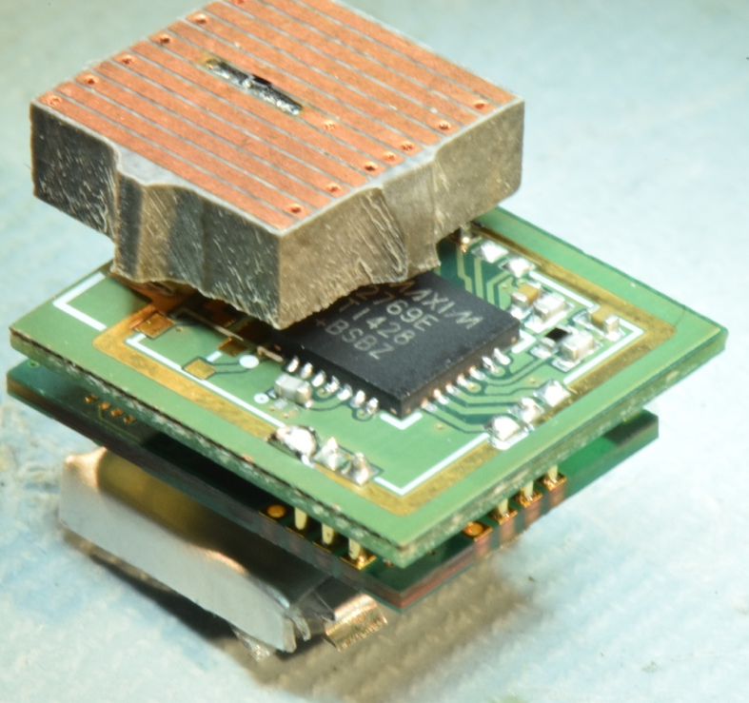
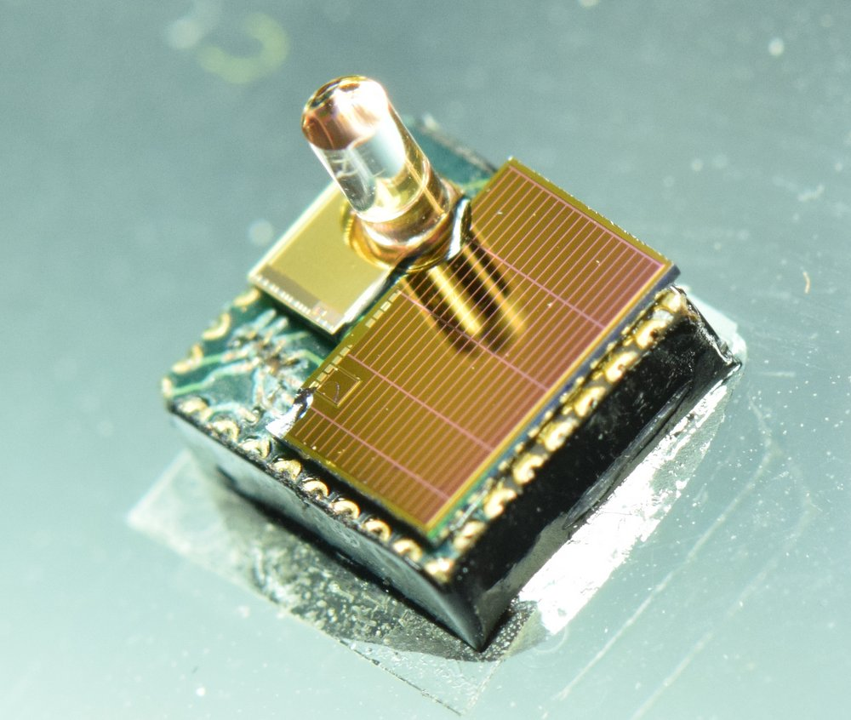
Seamless and transparent interaction between power-aware and power-oblivious chips
Facilitates integration with COTS chips
*No current COTS chip support MBus, these integrations leverage more traditional buses still

Slide 41
The majority of interconnect research is focused on performance at the expense of power and area
31.5 GB/s
5 Gb/s
115 b/s
22.8 MB/s
43.5 million times faster
1,381
times faster

Slide 42
Specification and Verilog at http://mbus.io
Control/
PMU
Decap
Temp Sensor
Radio
+ CDC
2 uAh Battery
5 uAh Battery
MEMS
P. Sensor
Motion Detection/ Imager
Pressure Sensing
Temp. Sensing
Visual Sensing

Slide 43
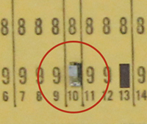
MBus-based smart dust now on display at the computer history museum

Slide 44
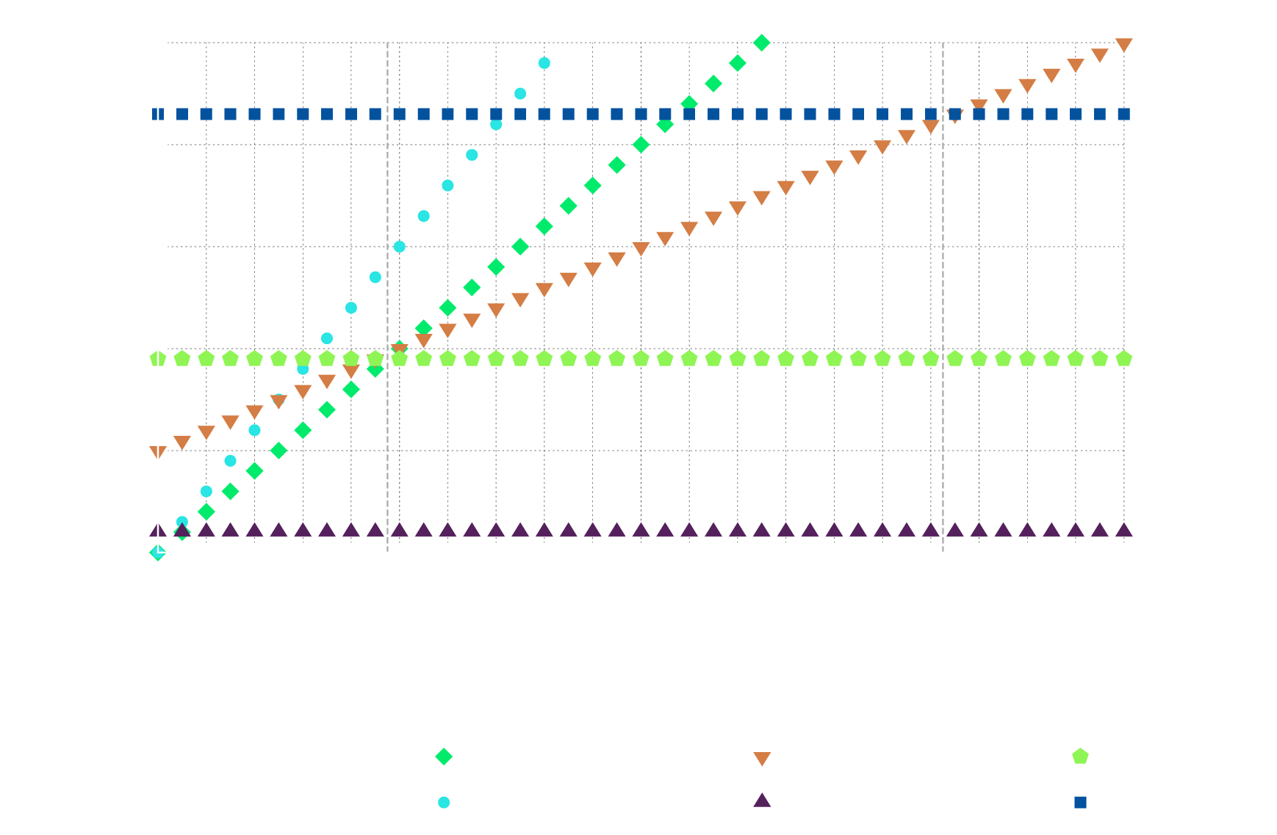
Protocol Overhead and message length

Slide 45
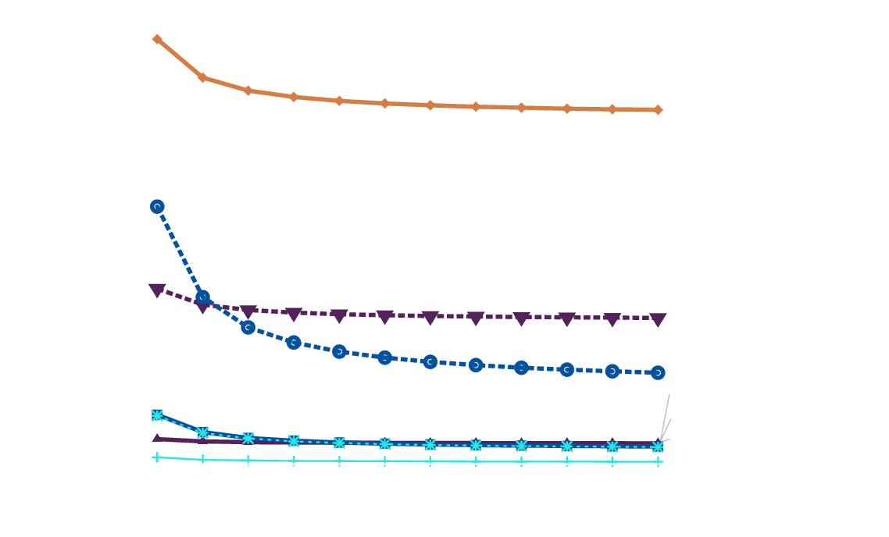
Energy per bit of goodput (useful data)

Slide 46

Power Draw Comparison

Slide 47

Goodput of parallel MBus

Slide 48

Saturating Transaction Rate

Slide 49

Adding additional nodes does not have significant impact on MBus latency
MBus Mediator
Clock
Recall: “shoot through”
Data
DATA_IN
DATA_OUT
MBus Member
1
1
MBus Member
MBus Member
10 ns
~7 MHz
10 ns
MBus Member

Slide 50
Some low-hanging fruit…
Full Duplex is trivial
“Selectively parallel”

Slide 51
Arbitration Detail

Slide 52
Interjection Detail

Slide 53
Tertiary node power-on request

Slide 54

Hierarchical Power Domains

Slide 55

Implementation

Slide 57
2 phase clocking
CICC ref
But how much data do you transmit?
MBus: A 17.5 pj/bit/chip Portable Interconnect Bus for Millimeter-Scale Sensor Systems with 8 nW Standby Power
Ye-Sheng Kuo, Pat Pannuto, Gyouho Kim, Zhiyoong Foo, Inhee Lee, Ben Kempke, Prabal Dutta, David Blaauw, and Yoonmyung Lee
IEEE Custom Integrated Circuits Conference (CICC), September 2014

Slide 58
“Dark silicon” is more like “dimly lit silicon”
Clock-gated modules still exhibit static leakage
Blows mm-scale power budget
mm-scale systems perform power-gating
This means modules are cold-booting all the time
A little easier for monolithic designs
CPU
Radio
Timer
Sensor
Flash

Slide 59









2008: The Phoenix Processor
World’s lowest power computer
Set records for volume and energy
And could be used by at best the grad students that built it
Mingoo Seok
Scott Hanson
Yu-Shiang Lin
ZhiYoong Foo
Daeyeon Kim
Yoonmyung Lee
Nurrachman Liu
Dennis Sylvester
David Blaauw
The Phoenix Processor: A 30pW Platform for Sensor Applications, M. Seok, VLSI ‘08
Notes:
Phoenix: Mingoo Seok, Scott Hanson, Yu-Shiang Lin, Zhiyoong Foo, Daeyeon Kim, Yoonmyung Lee, Nurrachman Liu, Dennis Sylvester, David Blaauw
IOP: Gregory Chen, Hassan Ghaed, Razi-ul Haque, Michael Wieckowski, Yejoong Kim, Gyouho Kim, David Fick, Daeyeon Kim, Mingoo Seok, Kensall Wise, David Blaauw, Dennis Sylvester

Slide 60

From temperature sensor to pressure sensor: 3 Years.
0.7 mm
2 mm
1.2 mm
Motivating application for mm-scale sensor: Intraocular pressure
Critical diagnostic tool for glaucoma
A Cubic-Millimeter Energy-Autonomous Wireless Intraocular Pressure Monitor, G. Chen, ISSCC ‘11
Notes:
http://blaauw.eecs.umich.edu/getFile.php?id=434&sid=vomuvflatyhha
IoP – 1.2 mm wide, 2 mm long, 0.7 mm high, 0.35 mm high battery

Slide 61
Clock-gating != power-gating and modules != chips
A gated module has a stable clock available when it’s ready to wake up

Slide 62
What does this enable: Completely clockless member nodes

Slide 63
What Problem Does this create: How to arbitrate w/out a clock?

Slide 64




This talk is about technology for Application-Driven Hardware
Systems that require assembly-time modularity
Describes majority of “smart, networked devices”
Charger: TI
Accelerometer: STMicro
CPU: STMicro
Flash: Micron
Magnetometer: Xtrinsic
CPU: STMicro
Charger: TI
Accelerometer: STMicro
RF/Comm: Nordic Semi
https://www.ifixit.com/Teardown/Fitbit+Flex+Teardown/16050
https://www.ifixit.com/Teardown/Pebble+Teardown/13319

Slide 65



For nearly three decades, most microcontrollers have come with the same three interfaces
SPI, invented by Motorola in ~1979
Hub and spoke communication
(Can also ring)
I²C, invented by Phillips in 1982
Any-to-(m)any on one shared bus
UART, simple differential signaling
Point-to-point on dedicated links

Slide 66
In the coming decades, these three interfaces will no longer be sufficient
SPI
Too many wires
Wrong (centralized) architecture
I²C
Too inefficient
UART
Wrong (not a bus) architecture
Slow

Slide 67
To understand why requires predicting what computing will look like decades from now
“Roughly every decade a new, lower priced computer class forms based on a new programming platform, network, and interface resulting in new usage and the establishment of a new industry.”
- Gordon Bell [1972,2008]

Slide 68

Nakagawa’s Corollary to Bell’s Law observes that computer volume shrinks 100x every decade
Mainframe
Millimeter-scale devices will have previously unseen pressures for volume and energy budget
This work: Current interfaces cannot scale to meet the demands of next-generation systems
1 per Enterprise
Workstation
1 per Engineer
Size (mm³)
Laptop
1 per Professional
Smart Sensors
1 per Company
Mini Computer
Ubiquitous
1 per Family
Personal Computer
100 – 1000’s per person
1 per person
Smartphone
Image from The Computing Universe: A Journey through a Revolution, Tony Hey and Gyuri Pápay

Slide 69

Introducing: MBus
A new interconnect designed for next-generation nanopower systems
22.6 pJ / bit / chip, < 10 pW standby / chip
Single-ended (push-pull) logic
Low, fixed wire count (4)
Multi-master
Power-aware
Implemented in over a dozen mm-scale chips
CPU, Radio
Flash Memory
Temperature, Pressure, Imager

Slide 70
Constraints when computing at mm-scale
Target volume: ~1 mm³
Energy budget: 0.5 – 5 µAh battery
Energy Income: 1 – 10 nA, indoor photovoltaic

Slide 71
What Interfaces Currently Exist and Why Don’t They Work?
I²C
Energy
SPI
I/O Area
Single-Master
UART
Point-to-point only
Notes:
% i2c invented 1982
% spi loosely in 1979 as external mcu bus for moto 68000

Slide 72
SPI’s I/O overhead fails the volume constraints for mm-scale systems
Single master design is inefficient, inflexible
Requires a dedicated IO line for each slave, does not scale
Requires 2 dedicated IO lines for slaves that can generate interrupts
Slave-to-slave costs four times the energy of multi-master
No protocol-level ACK mechanism
Most SPI peripherals have no ACK mechanism as a result
No feedback mechanism
Susceptible to overrun

Slide 73
Background: How are systems composed today?
One master, N slaves
Shared clock: SCLK
Shared data bus: MOSI
Shared data bus: MISO
One Slave Select line per slave
Send data between Master and Slave 1…
SPI, invented by Motorola in ~1979
Master
Slave 1
SCK
MOSI
MISO
SS0
SS1
…
SCLK
MOSI
MISO
SS
Slave 2
SCLK
MOSI
MISO
SS

Slide 74
Background: How are systems composed today?
One master, N slaves
Shared clock: SCLK
Shared data bus: MOSI
Shared data bus: MISO
One Slave Select line per slave
Send data between Master and Slave 1…
SPI, invented by Motorola in ~1979
Master
Slave 1
SCK
MOSI
MISO
SS0
SS1
…
SCLK
MOSI
MISO
SS
Slave 2
SCLK
MOSI
MISO
SS

Slide 75
Background: How are systems composed today?
One master, N slaves
Shared clock: SCLK
Shared data bus: MOSI
Shared data bus: MISO
One Slave Select line per slave
Send data between Master and Slave 1…
SPI, invented by Motorola in ~1979
Key Properties
Master controls all communication
One slave select line per slave

Slide 76
UART’s point-to-point topology also fails volume constraints
Only supports point-to-point links (not a bus)
Though many cm-scale systems have multiple UART frontends
Pre-negotiation of baud rate can be challenging
No feedback mechanism
(susceptible to buffer overrun)

Slide 77
Open-collector designs are too energy inefficient for mm-scale devices
Too much energy lost to pull-up
Consider a “better-than-optimal” I²C
1.2 V I/O Logic
15.5 kΩ resistor
400 kHz bus (2.5 μs)
No setup/hold margins
80% V_{DD} at last instant as logical 1
50 pF system capacitance
174 pJ minimum per bit
MBus is 22.6 pJ per bit measured
Notes:
(1/(400 kilohertz) * .5 * (1.2 volts / 10 kiloohms) * 1.2 volts) / (1 picojoule) = 180 pJ for SCL low
.5*400pF*(1.2V)**2 = 288 pJ cap
.5*400*1.2**2*(1-0**2) = 288 pJ
% 1/(400 kilohertz) * .5 * (1.2 volts / 15.5 kiloohms) * 1.2 volts = 116.13 pJ
% .5*50*(.8*1.2)**2 = 23.04 pJ -> capacitance
% .5*50*1.2**2*(1-.2**2) = 34.56 pJ -> resistor while charging
% SCL Generation: (172 picojoule) / (2.5 microsecond) = 69 µW

Slide 78
Can we fix the energy issue and use an i²c-like design?
Very simple bus design
Only requires two wires
Arbitration is “built-in”
Only problem is energy lost in the pullup...

Slide 79

Idea: Build I²C without the pull-ups
Replace pullup with explicit drivers and weak “keepers”
The Good: Able to achieve 88 pJ / bit
The Bad: Required clocks running at 5x bus clock on every chip
The Ugly: Hand-tuned, ratioed logic on every chip – Not synthesizable
A Modular 1 mm³ Die-Stacked Sensing Platform with Low Power I2C Inter-die Communication and Multi-Modal Energy Harvesting
Yoonmyung Lee, Suyoung Bang, Inhee Lee, Yejoong Kim, Gyouho Kim, Mohammed Hassan Ghaed, Pat Pannuto, Prabal Dutta, Dennis Sylvester, David Blaauw
IEEE Journal of Solid-State Circuits

Slide 80
Additional Motivation: Backwards compatibility with existing I²C Devices
The Ultra-Low Power I²C “looked like” I²C on the wire
No combinational circuit could connect them
Not actually backwards compatible
Ultra-Constrained Sensor Platform Interfacing
Pat Pannuto, Yoonmyung Lee, Benjamin Kempke, Dennis Sylvester, David Blaauw, and Prabal Dutta
IPSN 2012 (Demo)

Slide 81

What are the features that really matter for an ultra-constrained interconnect?

Slide 82
What are the features that really matter for an ultra-constrained interconnect?

Slide 83
Power-gating is key for low-power operation, but is difficult to manage at both the circuits and systems levels
Circuits Problem: Power-gating completely powers off modules
Result: Portions of chips are frequently cold-booting
Systems Problem: Power-gated nodes cannot communicate
Result: Need a means of tracking distributed state, synchronizing actions
Insight: Design a power-aware communication fabric
Support circuits by providing a stable clock during cold boot
Support systems by providing an “always-on” abstraction

Slide 84
What are the features that really matter for an ultra-constrained interconnect?

Slide 85
MBus Design: Physical Topology
Clock
Ring Topology
2 lines – 4 wires
Clock
Data
“Shoot-Through”
MBus Mediator
Data
MBus Member
MBus Member
MBus Member
MBus Member
CLK_IN
CLK_OUT

Slide 86
MBus Design: The Mediator Node
MBus system has one mediator and any number of members
Mediator node responsibilities:
Generate MBus clock
Mediate arbitration
Any node can initiate a transaction
MBus is still a “multi-master” bus
Mediator selection can be performed at system design time

Slide 87
MBus Design: Protocol
An MBus transmission has 4 phases:
Arbitration
Message Transmission
Interjection
Control

Slide 88
MBus Design: Protocol
An MBus transmission has 4 phases:
Arbitration
Message Transmission
Interjection
Control

Slide 89



MBus arbitration is simple, robust, and introduces a topological priority
MBus Mediator
Clock
Any node initiates at any time by pulling DATA_OUT low
Idle nodes forward IN to OUT
Except the mediator
Who never pulls DATA_OUT low
Member 1 also wants to send?
Mediator pulls CLK low
Then pulls CLK high
Members sample DATA_IN to see if they won arbitration
Data
MBus Member 4
MBus Member 1
MBus Member 3
MBus Member 2

Slide 90
MBus arbitration is simple, robust, and introduces a topological priority
MBus Mediator
Clock
Priorities are not new
I²C embeds priority in address
Topological is different though
See the paper for more details
Priority Arbitration
Starvation
Fairness
Data
MBus Member 4
MBus Member 1
MBus Member 3
MBus Member 2

Slide 91
MBus arbitration protocol enables its power-aware features
Insight
A node is either already powered
And thus paying attention to arbitration
Or not powered
And therefore guaranteed not to participate in arbitration
Use arbitration edges to wake chip

Slide 92
MBus hierarchical power domains minimize unneeded wakeups
Minimal components are always-on
Sleep controller
Wire controller
Lightweight bus controller wakes on every message
Checks for address match
Bus controller wakes chip
Buffers data if needed
See the paper for more details
Sleep Controller
Bus Controller
Chip
Wire Controller

Slide 93
MBus interjection provides unambiguous in-band end-of-message and robust reset
After arbitration, the winner sends destination address + data
MBus samples data on rising CLK, writes on falling CLK
<TODO: Pointer to CICC Paper?>
Insight: In normal operation, DATA never toggles faster than CLK
Can generate an “Interjection” by toggling DATA with clock
Advantage: Robust detection, counter clocked by DATA, reset by CLK
But mediator controls CLK
Nodes request injection by holding CLK high
MBus Mediator
Clock
Data
MBus Member
MBus Member
MBus Member
MBus Member

Slide 94
MBus implemented in a dozen chips and growing. Available today.
See http://mbus.io for full specification and reference Verilog

Slide 95
MBus is the glue that puts together the Michigan Micro Mote (M3) ecosystem

Slide 96

MBus An Ultra-Low Power Interconnect for Next Generation Nanopower Systems
http://mbus.io

Slide 98
This talk aims to show that the interconnect is/will be the bottleneck for next-gen, mm-scale systems
Show how we can address this issue with a new interface tech
Show new features and why they’re important (power-aware)
Close w/ M3 ecosystem

Slide 99

Mainframe
100x smaller every decade
1 per Enterprise
[Nakagawa08]
Workstation
1 per Engineer
Size (mm³)
Laptop
1 per Professional
Smart Sensors
1 per Company
Mini Computer
Ubiquitous
1 per Family
Personal Computer
100 – 1000’s per person
1 per person
Smartphone

Slide 100
Claim
We will not realize the projected proliferation of intelligent, networked devices
without the adoption of a new interconnect technology.

Slide 101



We will not realize the projected proliferation of intelligent, networked devices
without the adoption of a new interconnect technology.
Gartner Hype
Cycle 2014
Notes:
http://blogs.cisco.com/news/cisco-connections-counter

Slide 102

We will not realize the projected proliferation of intelligent, networked devices
without the adoption of a new interconnect technology.
http://blogs.cisco.com/news/cisco-connections-counter
Gartner Hype
Cycle 2014
Notes:
http://blogs.cisco.com/news/cisco-connections-counter

Slide 103
We will not realize the projected proliferation of intelligent, networked devices
without the adoption of a new interconnect technology.
http://blogs.cisco.com/news/cisco-connections-counter
Notes:
http://blogs.cisco.com/news/cisco-connections-counter

Slide 104
We will not realize the projected proliferation of intelligent, networked devices
without the adoption of a new interconnect technology.
http://blogs.cisco.com/news/cisco-connections-counter
Notes:
http://blogs.cisco.com/news/cisco-connections-counter

Slide 105
We will not realize the projected proliferation of intelligent, networked devices
without the adoption of a new interconnect technology.

Slide 106

We will not realize the projected proliferation of intelligent, networked devices
without the adoption of a new interconnect technology.

Slide 107
We will not realize the projected proliferation of intelligent, networked devices
without the adoption of a new interconnect technology.

Slide 108
We will not realize the projected proliferation of intelligent, networked devices
without the adoption of a new interconnect technology.
Extend these estimates to 2050:
10 Billion People
3 Trillion Devices

Slide 109



x
x
x
We will not realize the projected proliferation of intelligent, networked devices
without the adoption of a new interconnect technology.
Extend these estimates to 2050:
10 Billion People
3 Trillion Devices
Devices will outnumber people 300:1
Notes:
http://files.tested.com/photos/2013/12/17/56333-tracker_lineup.jpg

Slide 110
A (Revised) Claim
We will not realize the projected proliferation of intelligent, networked devices
without further scaling down the size and energy demand of devices.
We will not realize an ecosystem of mm-scale, nanopower devices without the adoption of a new interconnect technology.

Slide 111
Corollary To The Bold Claim
We will not see a proliferation of mm-scale computing devices without the adoption of a new interface technology.

Slide 112
Claim
We will not see a proliferation of mm-scale computing devices without the adoption of a new interface technology.
Sub-Claim
Proliferation requires an ecosystem of composable modules that creative individuals can leverage to build new and novel systems.
Notes:
https://www.ifixit.com/Teardown/Fitbit+Flex+Teardown/16050
http://electronics360.globalspec.com/article/3128/teardown-fitbit-flex
https://plus.google.com/photos/107696725527584609973/albums/5806291983792940817
https://www.ifixit.com/Teardown/Pebble+Teardown/13319

Slide 113
Claim
We will not see a proliferation of mm-scale computing devices without the adoption of a new interface technology.
Sub-Claim
Proliferation requires an ecosystem of composable modules that creative individuals can leverage to build new and novel systems.
Charger: TI
Accelerometer: STMicro
CPU: STMicro
Flash: Micron
Magnetometer: Xtrinsic
CPU: STMicro
Charger: TI
Accelerometer: STMicro
RF/Comm: Nordic Semi
https://www.ifixit.com/Teardown/Fitbit+Flex+Teardown/16050
https://www.ifixit.com/Teardown/Pebble+Teardown/13319
Notes:
https://www.ifixit.com/Teardown/Fitbit+Flex+Teardown/16050
http://electronics360.globalspec.com/article/3128/teardown-fitbit-flex
https://plus.google.com/photos/107696725527584609973/albums/5806291983792940817
https://www.ifixit.com/Teardown/Pebble+Teardown/13319

Slide 114

Claim
We will not see a proliferation of mm-scale computing devices without the adoption of a new interface technology.
Sub-Claim
Proliferation requires an ecosystem of composable modules that creative individuals can leverage to build new and novel systems.
CPU: STMicro
Charger: TI
Accelerometer: STMicro
RF/Comm: Nordic Semi
RF/Bluetooth: Panasonic
https://www.ifixit.com/Teardown/Fitbit+Flex+Teardown/16050
https://www.ifixit.com/Teardown/Pebble+Teardown/13319
Notes:
https://www.ifixit.com/Teardown/Fitbit+Flex+Teardown/16050
http://electronics360.globalspec.com/article/3128/teardown-fitbit-flex
https://plus.google.com/photos/107696725527584609973/albums/5806291983792940817
https://www.ifixit.com/Teardown/Pebble+Teardown/13319

Slide 115

Claim
We will not see a proliferation of mm-scale computing devices without the adoption of a new interface technology.
Sub-Claim
Proliferation requires an ecosystem of composable modules that creative individuals can leverage to build new and novel systems.
CPU: STMicro
Charger: TI
Accelerometer: STMicro
RF/Comm: Nordic Semi
RF/Bluetooth: TI
https://www.ifixit.com/Teardown/Fitbit+Flex+Teardown/16050
https://www.ifixit.com/Teardown/Pebble+Teardown/13319
Notes:
https://www.ifixit.com/Teardown/Fitbit+Flex+Teardown/16050
http://electronics360.globalspec.com/article/3128/teardown-fitbit-flex
https://plus.google.com/photos/107696725527584609973/albums/5806291983792940817
https://www.ifixit.com/Teardown/Pebble+Teardown/13319

